Slide 1




Ninh Hiep Primary School
Welcome to our class 3B
Teacher: Nguyen Van Long
G
O
I
G
O
D
M
R
N
O
N

Slide 2
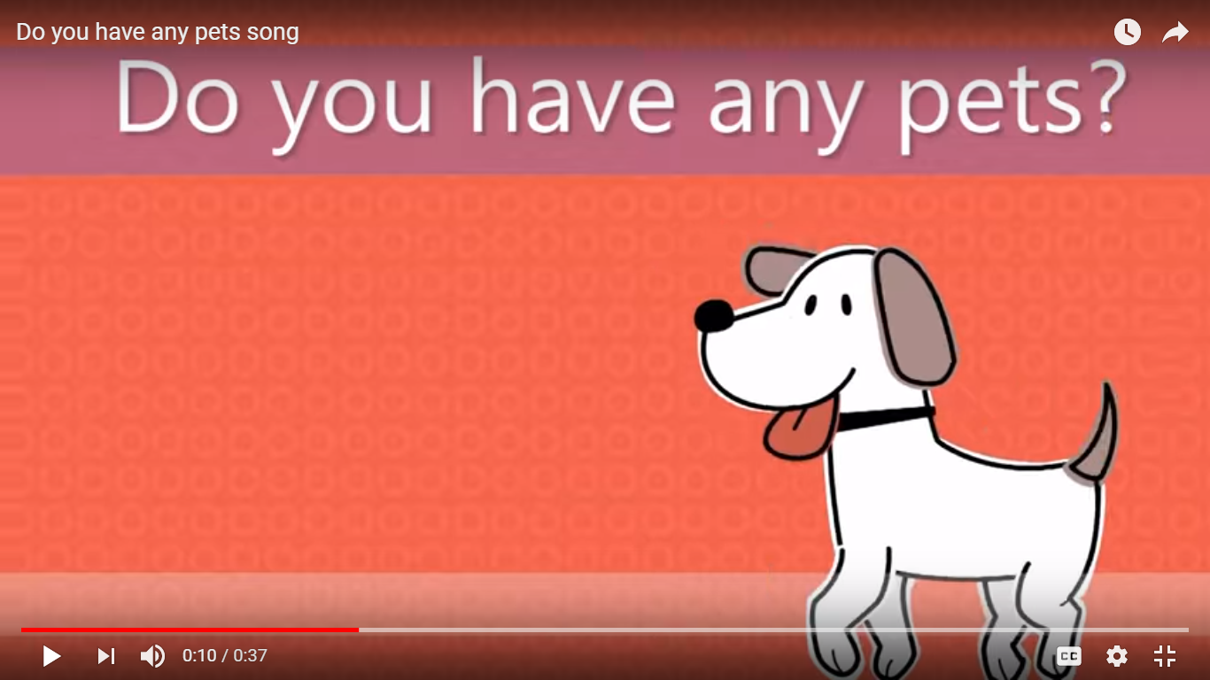


Slide 3
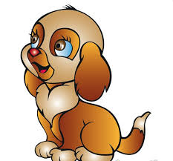
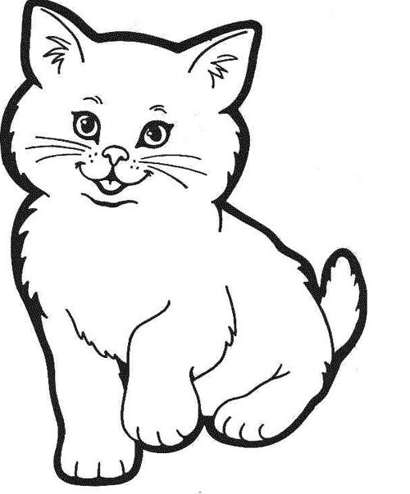
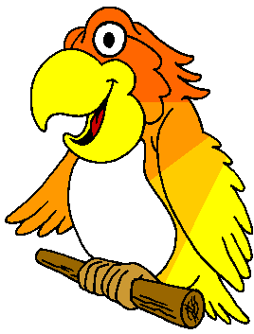
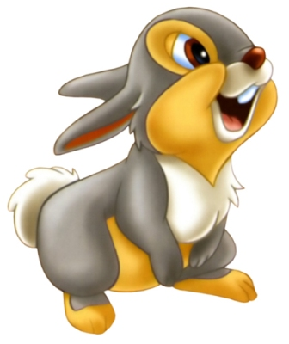

Play a game
2
3
1
5
4

Slide 4




Thursday, March 22nd 2018
Unit 16: Do you have any pets?
Lesson 3
Sounds.
Listen and write.
3. Circle and write.
4. Color and say.

Slide 5
Thursday, March 22nd 2018
Unit 16: Do you have any pets?
Lesson 3
1. Sounds.
o
o
hot pot dog robot
carrot parrot

Slide 6
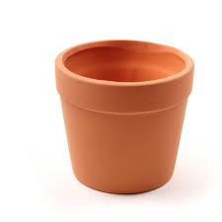
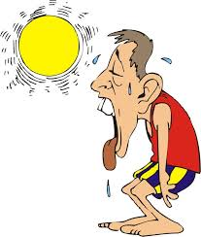
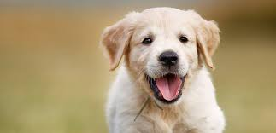
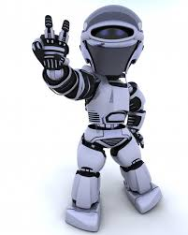

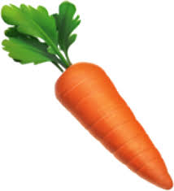
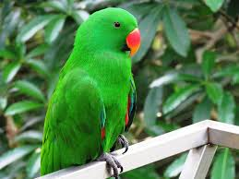

hot
pot
dog
robot
carrot
parrot

Slide 7
Listen and say
o
robot
hot
dog
pot

Slide 8
Listen and say
o
carrot
parrot

Slide 9
o
robot
hot
doctor
pot
dog
o
pilot
parrot
carrot
doctor

Slide 10
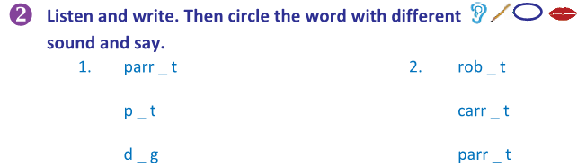
O
O
O
O
O
O

Slide 11




3
Circle, then sort and write
dogparrotrobotpothotcarrottoy
dog parrot robot pot hot carrot toy
o o
dog parrot
robot carrot
pot
hot
toy
Notes:
11

Slide 12
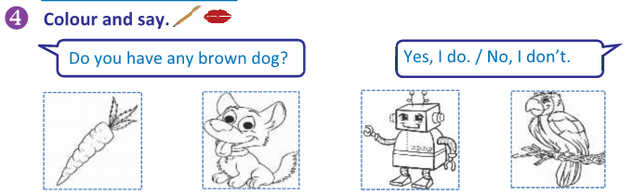
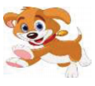

Slide 13
reference
sounds
o / o
animals
and
colours
Notes:
13

Slide 14



HOMEWORK:
- Find some other words which have “o” sounds
Prepare new lesson.

Slide 15
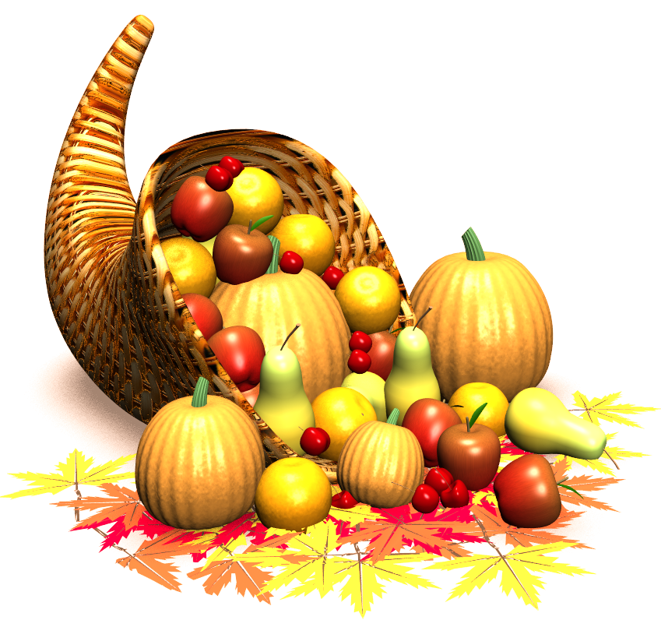


goodbye and see you again .
Thank you for your attention!

